Slide 1
Partitioner
CSC 4760 / 6760 Big Data Programming
Spring 2018

Slide 2
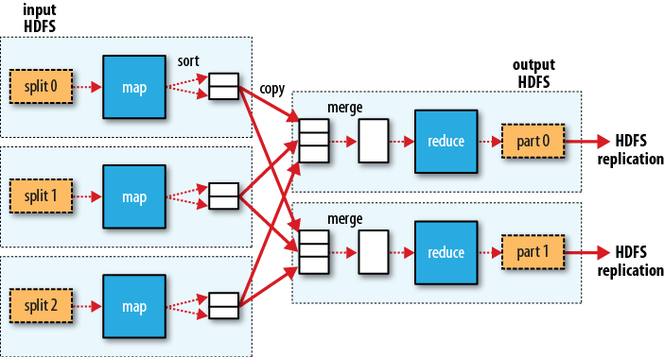
combiner
MapReduce data flow in Hadoop

Slide 3
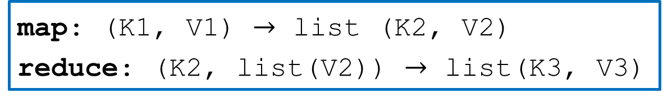
MapReduce Types - Mapper
map: (K1, V1) $→$ list (K2, V2)
reduce: (K2, list(V2)) $→$ list(K3, V3)
public class Mapper<KEYIN, VALUEIN, KEYOUT, VALUEOUT>{
private Text OutputKey = new Text();
private YourClass OutputValue = new YourClass();
protected void map(KEYIN key, VALUEIN value, Context context) throws IOException, InterruptedException{
// ⋯
context.write(OutputKey, OutputValue);
}
}

Slide 4
MapReduce Types - Reducer
map: (K1, V1) $→$ list (K2, V2)
reduce: (K2, list(V2)) $→$ list(K3, V3)
public class Reducer<KEYIN, VALUEIN, KEYOUT, VALUEOUT>{
private YourClass OutputValue = new YourClass();
protected void reduce(KEYIN key, VALUEIN value, Context context) throws IOException, InterruptedException{
// ⋯
context.write(key, OutputValue);
}
}

Slide 5
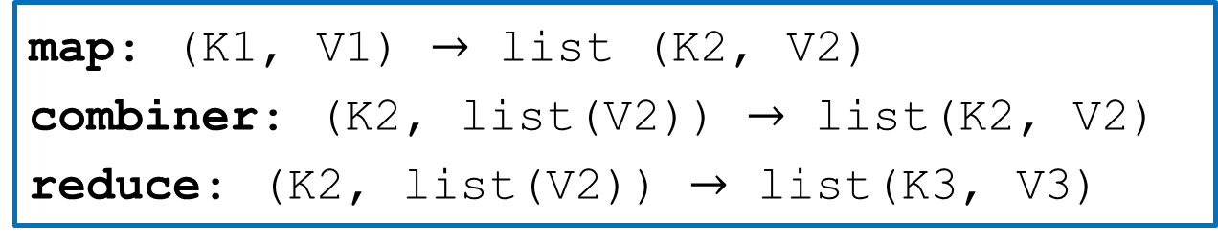
MapReduce Types - Combiner
map: (K1, V1) $→$ list (K2, V2)
combiner: (K2, list(V2)) $→$ list(K2, V2)
reduce: (K2, list(V2)) $→$ list(K3, V3)
Often the combiner and reduce functions are the same, in which case K3 is the same as K2, and V3 is the same as V2.

Slide 6
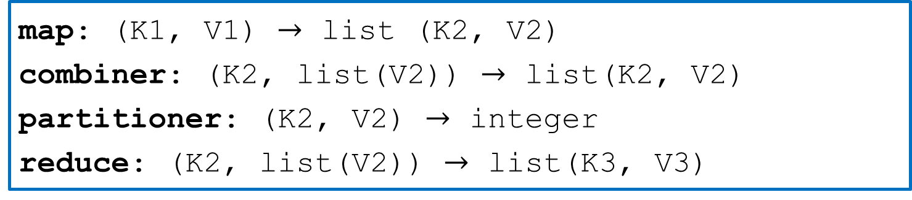
MapReduce Types - Partitioner
map: (K1, V1) $→$ list (K2, V2)
combiner: (K2, list(V2)) $→$ list(K2, V2)
partitioner: (K2, V2) $→$ integer
reduce: (K2, list(V2)) $→$ list(K3, V3)
The partition function operates on the intermediate key and value types (K2 and V2) and returns the partition index.
In practice, the partition is determined solely by the key (the value is ignored).

Slide 7
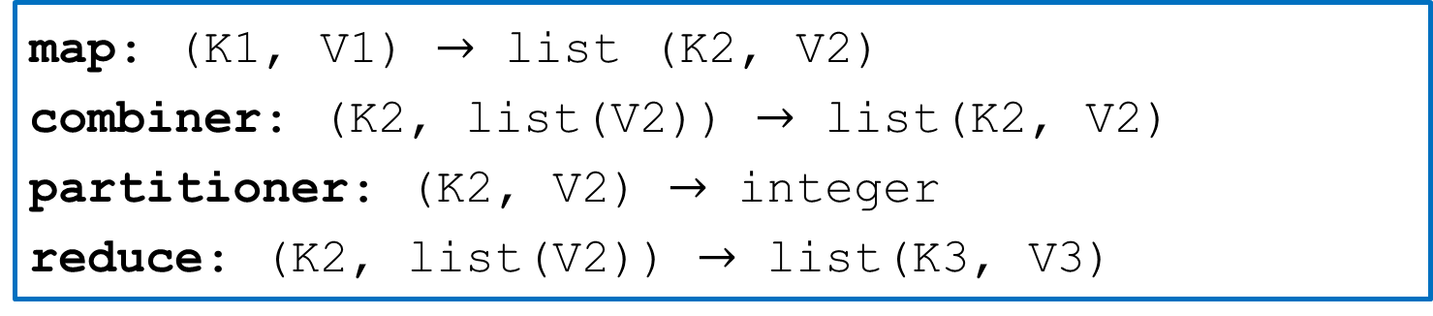
MapReduce Types - Partitioner
map: (K1, V1) $→$ list (K2, V2)
combiner: (K2, list(V2)) $→$ list(K2, V2)
partitioner: (K2, V2) $→$ integer
reduce: (K2, list(V2)) $→$ list(K3, V3)
public abstract class Partitioner<KEY, VALUE>{
public abstract int getPartition(KEY key, VALUE value, int numPartitions);
}

Slide 8
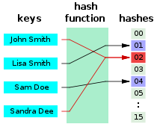
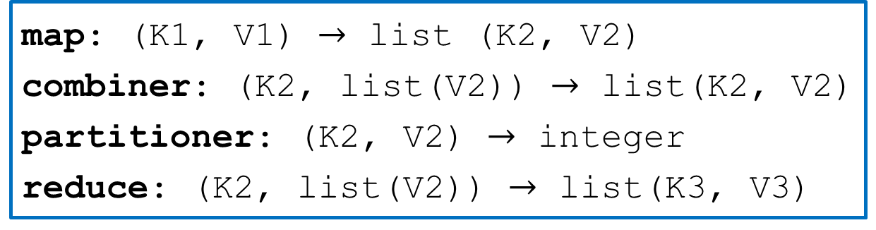
Default Partitioner in MapReduce
map: (K1, V1) $→$ list (K2, V2)
combiner: (K2, list(V2)) $→$ list(K2, V2)
partitioner: (K2, V2) $→$ integer
reduce: (K2, list(V2)) $→$ list(K3, V3)
public class HashPartitioner<KEY,VALUE> extends Partitioner<K,V>{
public int getPartition(KEY key, VALUE value, int numReduceTasks){
return (key.hashcode() & Integer.MAX_VALUE % numReduceTasks);
}
}
To remove the sign bit. in the case that the hashCode is a negative number. its like Math.abs(key.hashCode())
“numReduceTasks” means “numPartitions” here.

Slide 9

RandomPartitioner in MapReduce
map: (K1, V1) $→$ list (K2, V2)
combiner: (K2, list(V2)) $→$ list(K2, V2)
partitioner: (K2, V2) $→$ integer
reduce: (K2, list(V2)) $→$ list(K3, V3)
public class RandomPartitioner<KEY,VALUE> extends Partitioner<K,V>{
public int getPartition(KEY key, VALUE value, int numReduceTasks){
return (RandomNumber() % numReduceTasks);
}
}
“RandomNumber()” function can generate a random number
“numReduceTasks” means “numPartitions” here.

Slide 10

Hadoop Partitioner
map: (K1, V1) $→$ list (K2, V2)
combiner: (K2, list(V2)) $→$ list(K2, V2)
partitioner: (K2, V2) $→$ integer
reduce: (K2, list(V2)) $→$ list(K3, V3)
Partitioner controls the partitioning of the keys of the intermediate map-outputs.
Key in the <Key, Value> pair in the output of the Mappter controls the partition, typically by a hash function.
The number of partitioner is the same as the number of reducer
Each reducer will process the intermediate pairs in one partition
A Partitioner is created only when there are multiple reducers.

Slide 11
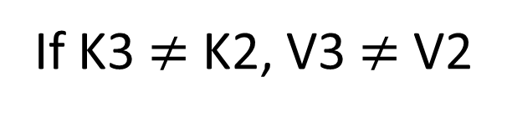
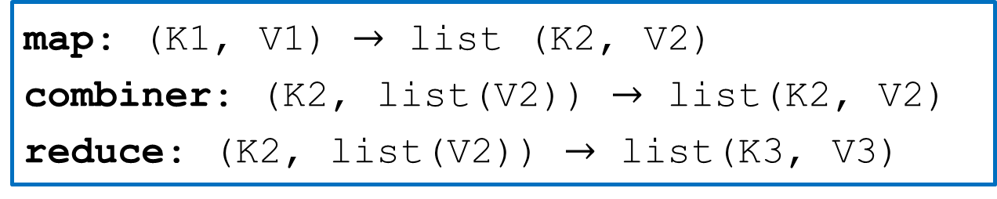
MapReduce Types
map: (K1, V1) $→$ list (K2, V2)
combiner: (K2, list(V2)) $→$ list(K2, V2)
reduce: (K2, list(V2)) $→$ list(K3, V3)
If K3 = K2, V3 = V2
If K3 $≠$ K2, V3 $≠$ V2
setOutputKeyClass(); // K3, K2
setOutputValueClass(); // V3, V2
setOutputKeyClass(); // K3
setOutputValueClass(); // V3
setMapOutputKeyClass(); // K2
setMapOutputValueClass(); // V2

Slide 12
Data Organization Patterns
The structured to hierarchical pattern
The partitioning and binning patterns
The total order sorting and shuffling patterns
The generating data pattern

Slide 13
Partitioning
Intent:
The intent is to take similar records in a dataset and partition them into distinct, smaller datasets.
Pattern Description
The pattern moves the records into categories (i.e., shards, partitions, or bins). Do not care about the order of records.

Slide 14
Re-Organizing the Data
User | Year of last access data
Bill | 2008
John | 2008
User information table
User | Year of last access data
Bill | 2008
Smith | 2010
Susan | 2009
John | 2008
Sophia | 2009
David | 2010
James | 2010
Partition by Year
User | Year of last access data
Susan | 2009
Sophia | 2009
User | Year of last access data
Smith | 2010
David | 2010
James | 2010

Slide 15
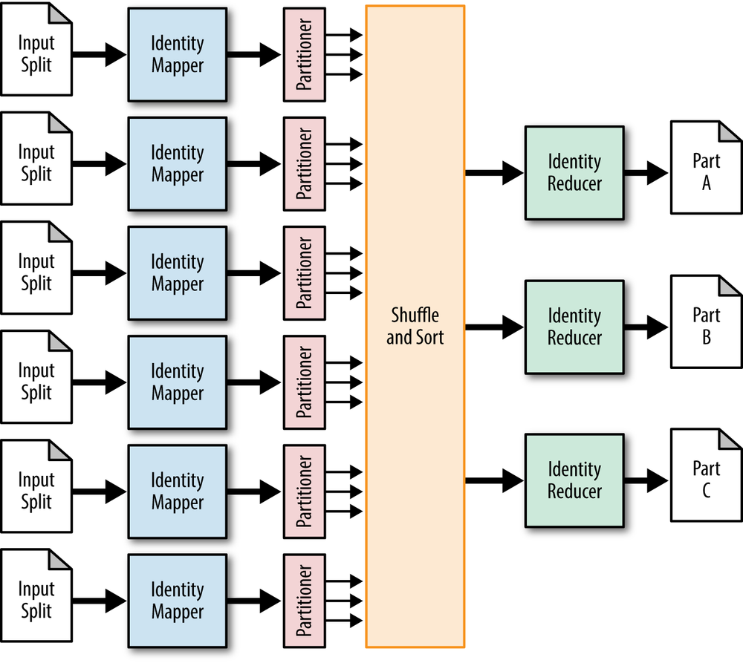
The Structure
The partitioner partitions the data!
Custom Partitioner
You define the function that determines what partition a record is going to go to
Each reducer corresponds to one particular partition.
One part file for each partition

Slide 16
Problem – Partitioning by Last Access Date
Given a list of user’s information,
(Original order: registration)
Partition the records based on the year of last access date, one partition per year (2008 – 2011, 4 years)
Basic idea (without using partitioner)
 | Mapper | Reducer
Input | One user’s information | <Key=LastAccessDate, User’s Information>
Output | <Key=LastAccessDate, User’s Information> | <null, All user’s information with the same last access year>

Slide 17
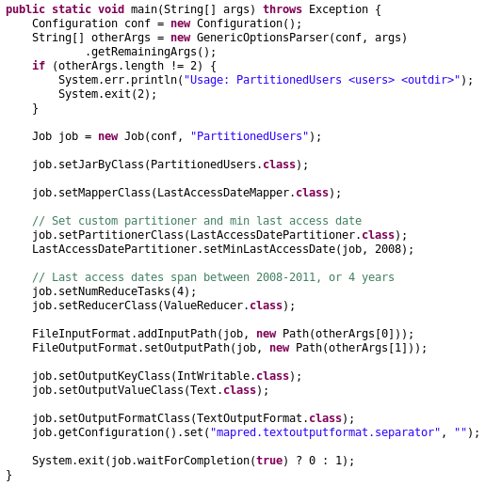
Main function
You have to know the number of partitions/reducers before you run this program
Source code “PartitionedUsers.java”

Slide 18
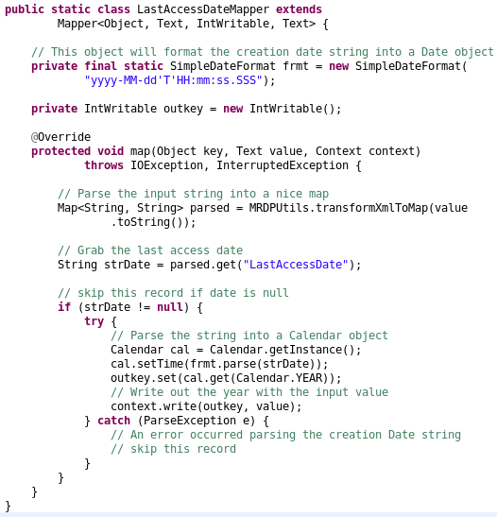
Mapper
Source code “PartitionedUsers.java”

Slide 19
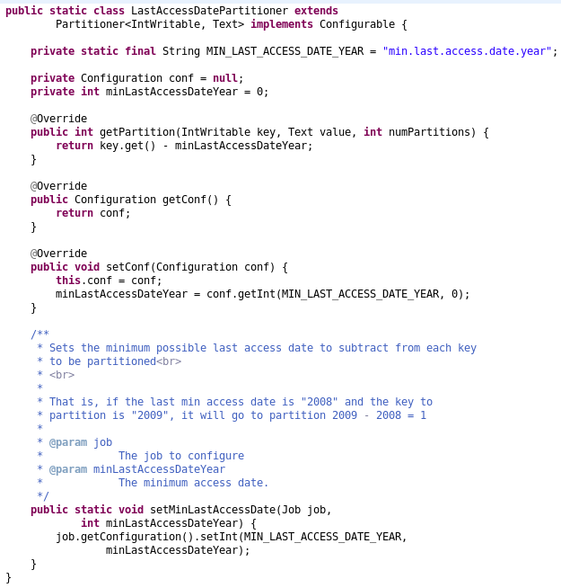
Partitioner
Source code “PartitionedUsers.java”

Slide 20
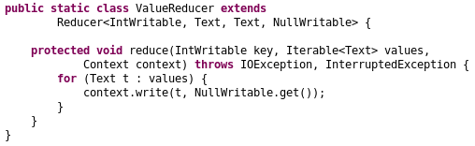
Reducer
Combiner?
Source code “PartitionedUsers.java”

Slide 21
One More Example
https://www.tutorialspoint.com/map_reduce/map_reduce_partitioner.htm

Slide 22
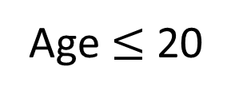
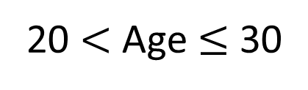
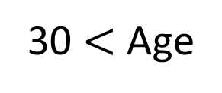
User information table
Age $≤$ 20
Id | Name | Age | Gender | Salary
1201 | gopal | 45 | Male | 50,000
1202 | manisha | 40 | Female | 51,000
1203 | khalil | 34 | Male | 30,000
1204 | prasanth | 30 | Male | 31,000
1205 | kiran | 20 | Male | 40,000
1206 | laxmi | 25 | Female | 35,000
1207 | bhavya | 20 | Female | 15,000
1208 | reshma | 19 | Female | 14,000
1209 | kranthi | 22 | Male | 22,000
1210 | Satish | 24 | Male | 25,000
1211 | Krishna | 25 | Male | 26,000
1212 | Arshad | 28 | Male | 20,000
1213 | lavanya | 18 | Female | 8,000
User | Maximum Salary
Female | 15,000
Male | 40,000
20 $<$ Age $≤$ 30
Partition by Age
User | Maximum Salary
Female | 35,000
Male | 31,000
30 $<$ Age
User | Maximum Salary
Female | 51,000
Male | 50,000

Slide 23
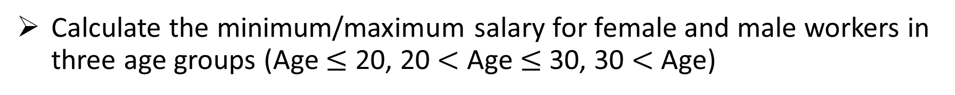
Problem – Partitioning + Summarization
Given a list of user’s information,
(Original order: random)
Calculate the minimum/maximum salary for female and male workers in three age groups (Age $≤$ 20, 20 $<$ Age $≤$ 30, 30 $<$ Age)
Basic idea (without using partitioner)
 | Mapper | Reducer
Input | One user’s information | <Key=Female/Male, Value=“Age, Salary”>
Output | <Key=Female/Male, Value=“Age, Salary”> | <Key=Female/Male, Max Salary in one age group>

Slide 24
Problem – Partitioning by Last Access Date
Given a list of user’s information,
(Original order: random)
Calculate the minimum/maximum salary for female and male workers in three age groups (Age $≤$ 20, 20 $<$ Age $≤$ 30, 30 $<$ Age)
Basic idea (without using partitioner)
 | Mapper | Reducer
Input | One user’s information | <Key=AgeGroup, Value=“Gender, Salary”>
Output | <Key=AgeGroup, Value=“Gender, Salary”> | <Key=AgeGroup, Max Salary in each gender>
Ideally, we have two keys.

Slide 25
The Structure
The partitioner partitions the data!
Custom Partitioner
You define the function that determines what partition a record is going to go to
Each reducer corresponds to one particular partition.
One part file for each partition

Slide 26
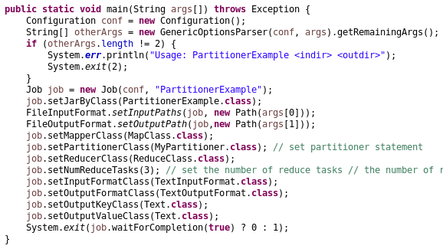
Main function
Source code “PartitionerExample.java”; Will be uploaded to iCollege
You have to know the number of partitions/reducers before you run this program

Slide 27
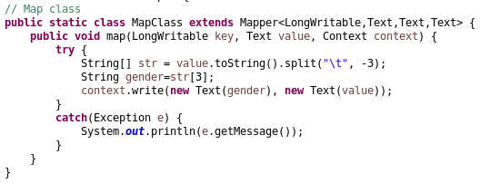
Mapper
Source code “PartitionerExample.java”; Will be uploaded to iCollege

Slide 28
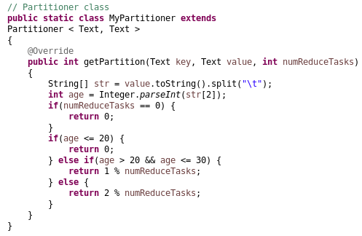
Partitioner
Source code “PartitionerExample.java”; Will be uploaded to iCollege

Slide 29
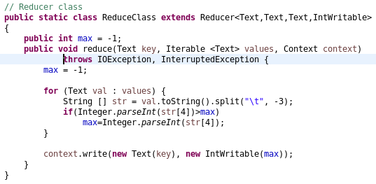
Reducer
In total, we have 2 unique keys;
In total, we have 3 reducers (when you run it, you will see the actual number of reducers by looking at the out files “part-r-00000”, “part-r-00001”, “part-r-00002”)
The number of reducers is not determined by the number of unique keys.
Computing the maximum salary
Source code “PartitionerExample.java”; Will be uploaded to iCollege
Combiner?

